Slide 1
EE4007 - OPTICAL ELECTRONICS
January 2010
© Alan P. Morrison
Lecture 8 - Optical fibre waveguides

Slide 2
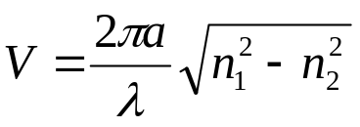
MODES IN STEP-INDEX FIBRES
January 2010
Mode chart similar to symmetric slab waveguide
fibre chart plotted as a function of normalised frequency, V
where a=core radius
Using V parameter, a single chart can be drawn that applies for any combination of a, λ, n₁ and n₂
EH and HE modes are hybrid, both containing components of electric and magnetic fields pointing along the fibre axis
Each curve on the mode chart represents 2 modes, each orthogonally polarised w.r.t. the other in the transverse plane
© Alan P. Morrison

Slide 3
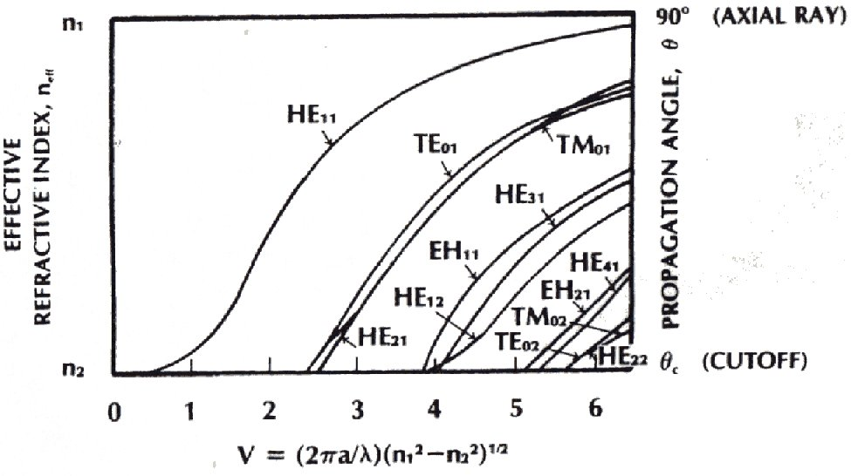
MODE-CHART FOR SI FIBRES
January 2010
© Alan P. Morrison

Slide 4
MODES IN STEP-INDEX FIBRES
January 2010
Conventional fibres don’t preserve polarisation of launched wave
  orthogonally polarised waves have same effective refractive index => easily couple energy between themselves
Effective refractive indices for all modes lie between core and cladding index
For large values of V, many modes will propagate
When V>10, number of modes is approximated by:
N=V²/2
Since the normalised frequency is proportional to the difference in refractive indices of the core and cladding, keeping this difference small reduces the number of propagating modes
© Alan P. Morrison

Slide 5
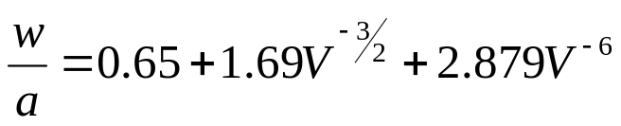
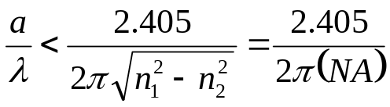
MODES IN STEP-INDEX FIBRES
The HE₁₁ mode is the lowest order mode for the SI fibre - its power distribution in the transverse plane is approx. Gaussian
The Gaussian approximation is good for V between 1.8 and 2.4
This is region where most single mode fibres are designed to operate
Spot size (mode field pattern) of equivalent Gaussian given by:
Single mode propagation is guaranteed if all modes except HE₁₁ are cut-off. This happens when: V<2.405 (refer to mode chart)
January 2010
© Alan P. Morrison

Slide 6
MODES IN STEP-INDEX FIBRES
January 2010
Two orthogonally polarised HE₁₁ modes can exist simultaneously but because they have the same effective refractive index, they travel at the same velocity
Exception to this rule => fibre exhibits birefringence - where refractive index depends on wave polarisation. It largely occurs due to lack of perfect circular symmetry in the refractive index
Can have polarisation preserving fibres as well as polarising fibres e.g. elliptical core / bow-tie fibre
Practical single-mode fibres have core diameters of around 4-12μm and cladding diameters of 125 μm
© Alan P. Morrison

Slide 7
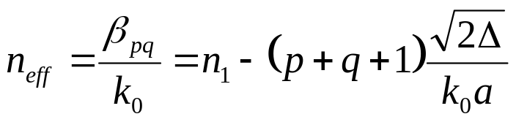
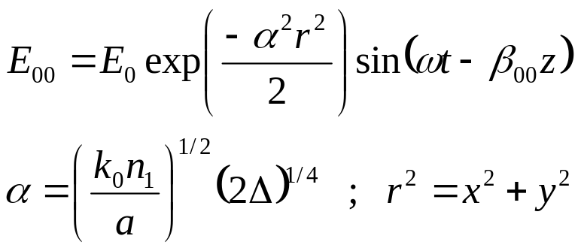
MODES IN GRADED-INDEX FIBRES
Concentrate on parabolic profile - other GRIN fibres are somewhat similar
Effective refractive index for a mode described by integers p and q
β=longitudinal propagation factor; k₀=free space propagation factor
lowest mode has p=q=0. Integers p and q are increased separately for each new mode
Lowest order mode has an electric field given by:
January 2010
© Alan P. Morrison

Slide 8
MODES IN GRADED-INDEX FIBRES
Transverse pattern is circularly symmetric and Gaussian shaped
Mode patterns for p=1, q=0 and p=2, q=0 are derived from:
As with dielectric waveguides, the allowed modes of propagation have effective refractive indices between core (axis) and clad refractive indices: n₂<=n_{eff}<=n₁
Cut-off occurs for any mode occurs when its effective refractive index equals n₂
Find cut-off condition for (1,0) mode to get condition for single mode propagation
January 2010
© Alan P. Morrison

Slide 9
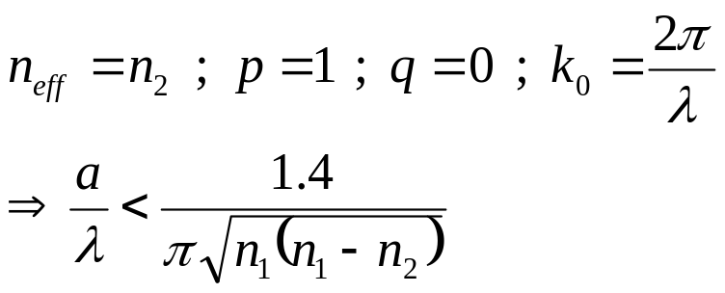
MODES IN GRADED-INDEX FIBRES
January 2010
Single mode condition:
Note: a/λ for single mode operation is 1.6 times larger for parabolic fibres than for SI fibres
note: making n₁ close to n₂ and operating at longer wavelengths will permit a larger core size for a single mode fibre
single mode graded index fibres provide no advantage over single mode SI fibres => single mode GRIN fibres are not normally produced
© Alan P. Morrison

Slide 10
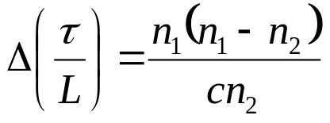
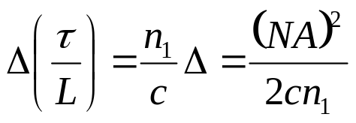
DISTORTION IN SI FIBRES
Signals are distorted in SI fibre by material and waveguide dispersion and by multimode pulse spreading
pulse spreading in the dielectric slab was found to be:
in terms of fractional index change and numerical aperture we can write
for typical glass values, n₁=1.48 and n₂=1.46, the pulse spreading per unit length is 67 ns/km
Most SI glass fibres have measured pulse spreads ~ 10-50ns/km
January 2010
© Alan P. Morrison

Slide 11
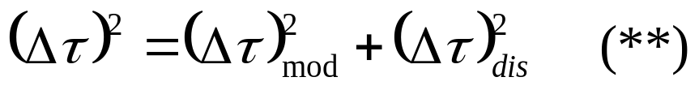
DISTORTION IN SI FIBRES
January 2010
We can conservatively use the theoretical result as an upper bound for the modal spreading
Total pulse spreading, due to both dispersion and modal distortion is given by:
modal distortion and dispersion do not add algebraically because they are linearly independent processes
Usually dispersion contributes only a small amount to the total spread in multimode SI fibres.
© Alan P. Morrison

Slide 12
EXAMPLE
January 2010
1 km of SI fibre with total pulse spread = 20 ns/km. At λ=0.82μm with Δλ = 20 nm (LED), pulse spread due to material dispersion = 2.2 ns/km (calculated in an earlier example).
From Equation (**) on previous slide we compute (Δτ)_{mod} to be 19.9 ns/km.
From this we can conclude that material dispersion is negligible under these circumstances.
© Alan P. Morrison

Slide 13
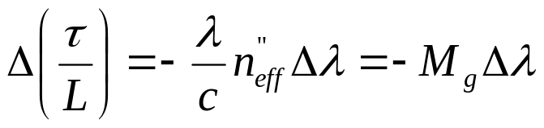
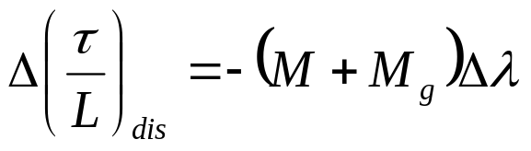
DISTORTION IN SI FIBRES
January 2010
Remember, waveguide dispersion occurs because the effective refractive index for any one mode varies with λ
Fibre waveguide spread given by:
Total dispersive spread computed by adding material and waveguide dispersion:
Waveguide dispersion << material dispersion for 800-900nm
© Alan P. Morrison

Slide 14
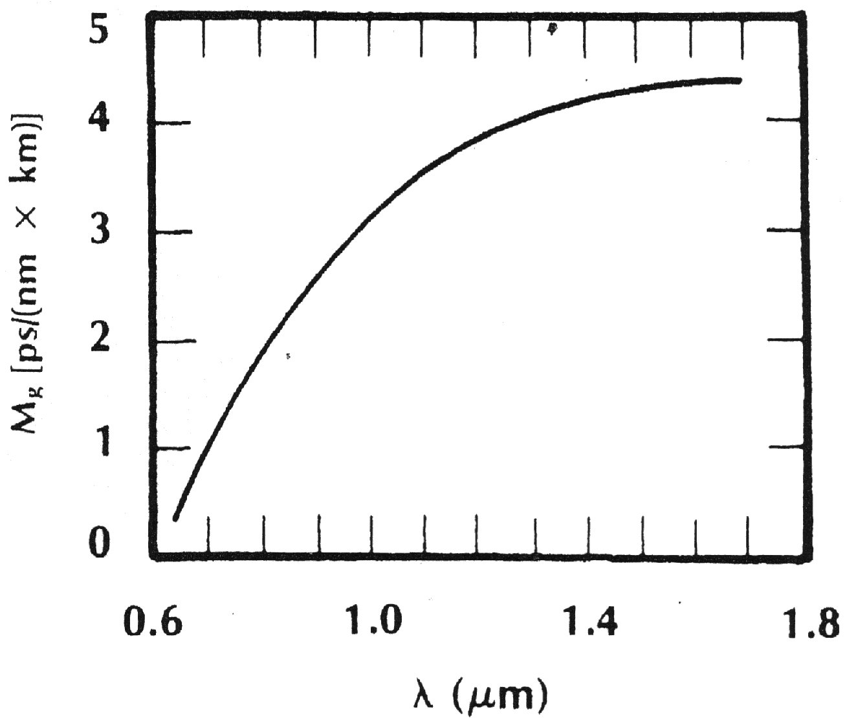
WAVEGUIDE DISPERSION IN SI FIBRE
January 2010
© Alan P. Morrison

Slide 15
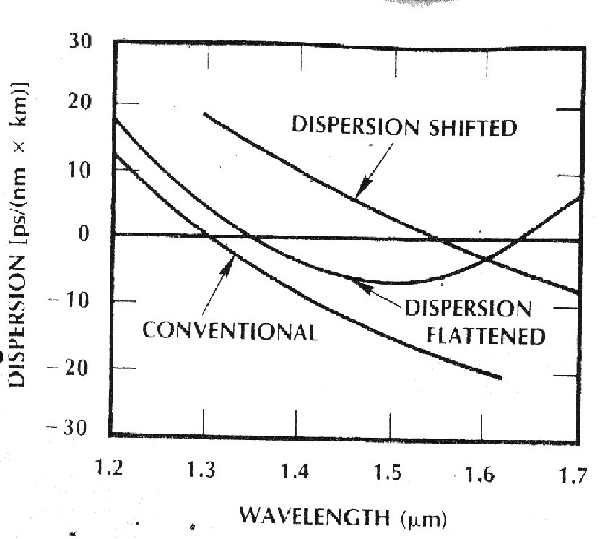
TOTAL DISPERSION IN SI FIBRES
January 2010
© Alan P. Morrison

Slide 16
DISTORTION IN SI FIBRES
January 2010
Example: at 0.82μm material dispersion is 110 ps/nm-km, whereas waveguide dispersion is only approx. 2 ps/nm-km
Waveguide broadening can be safely neglected, except for systems operating between 1200-1600nm
Pulse spread due to material and waveguide dispersion is proportional to source bandwidth - spread minimised using narrow linewidth LD
Modal distortion is usually dominant in multimode SI fibre, making LD largely ineffective for reducing the spread => LED sources normally chosen for systems using multimode SI fibres
© Alan P. Morrison

Slide 17
DISTORTION IN SINGLE-MODE FIBRES
January 2010
Suffer only from material and waveguide dispersion
see plot of pulse spread/unit length for single mode fibre
As expected, pulse spread is smaller for longer wavelengths and narrower source linewidth
At 1.3μm material dispersion is zero and so waveguide dispersion becomes very significant
Long, high-data-rate systems can be constructed by using single-mode fibres operating from 1.3 - 1.6μm
dispersion-shifted fibre => make min attenuation and min dispersion wavelengths coincide (triangular refractive index variation)
© Alan P. Morrison

Slide 18
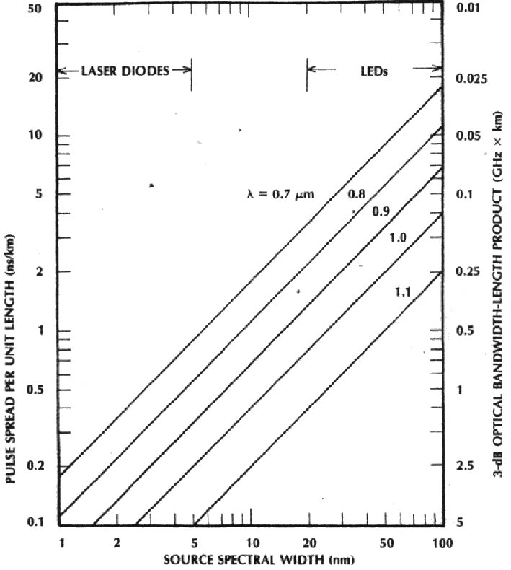
PULSE SPREAD PER UNIT LENGTH FOR SINGLE-MODE FIBRE
January 2010
© Alan P. Morrison

Slide 19
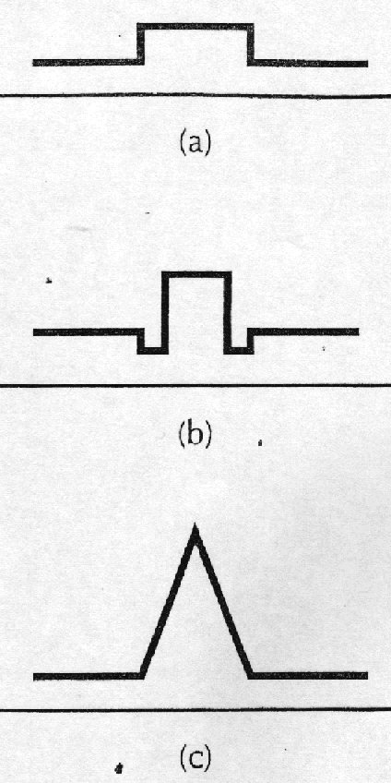
REFRACTIVE INDEX PROFILES
January 2010
matched-cladding
Depressed-cladding
Triangular fibres
© Alan P. Morrison

Slide 20
DISTORTION IN SINGLE-MODE FIBRES
January 2010
Dispersion-flattened fibre, using depressed cladding fibre
Dispersion flattened fibre can be used over a wide range of wavelengths from 1330-1600nm because of its uniformly low dispersion
Polarisation mode dispersion - due to birefringence, subtle phenomenon, complicated to evaluate
Example: design of single-mode fibre with n₁ close to n₂ so that the core can be relatively large. Assume n₁=1.465, n₂=1.46. NA of this fibre is: 0.12 and we find a/λ < 3.17 as condition for single mode operation
© Alan P. Morrison

Slide 21

DISTORTION IN SINGLE-MODE FIBRES
January 2010
Suppose we want to operate at 800nm, the core radius must be less than (0.8)(3.17)=2.54μm. => core diameter of about 5μm
If wavelength is changed to 1.3μm, then the fibre will still be single mode, however at 1.3μm we can afford to have a larger core diameter 2(1.3)(3.17)=8.24μm, however this will not be a single mode fibre at 800nm.
We can therefore derive an expression for the cut-off wavelength for single-mode operation in an SI fibre:
© Alan P. Morrison

Slide 22
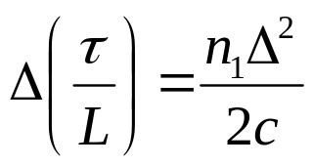
DISTORTION IN GRADED-INDEX FIBRES
January 2010
Multimode GRIN fibres have a pulse spread of only a few ns/km or less
  due to fact that non-axial rays (although travelling further) travel faster than axial rays because they are travelling in regions of lower refractive index => during time spent away from the axis, non-axial rays catch up with axial rays
Approximate expression for modal pulse spread in GRIN fibre is:
Example: fibre with n₁=1.48 and n₂=1.46 => Δ=0.0135, giving a pulse spread of 0.45 ns/km, a factor of 148 less than SI fibre
© Alan P. Morrison

